Slide 1
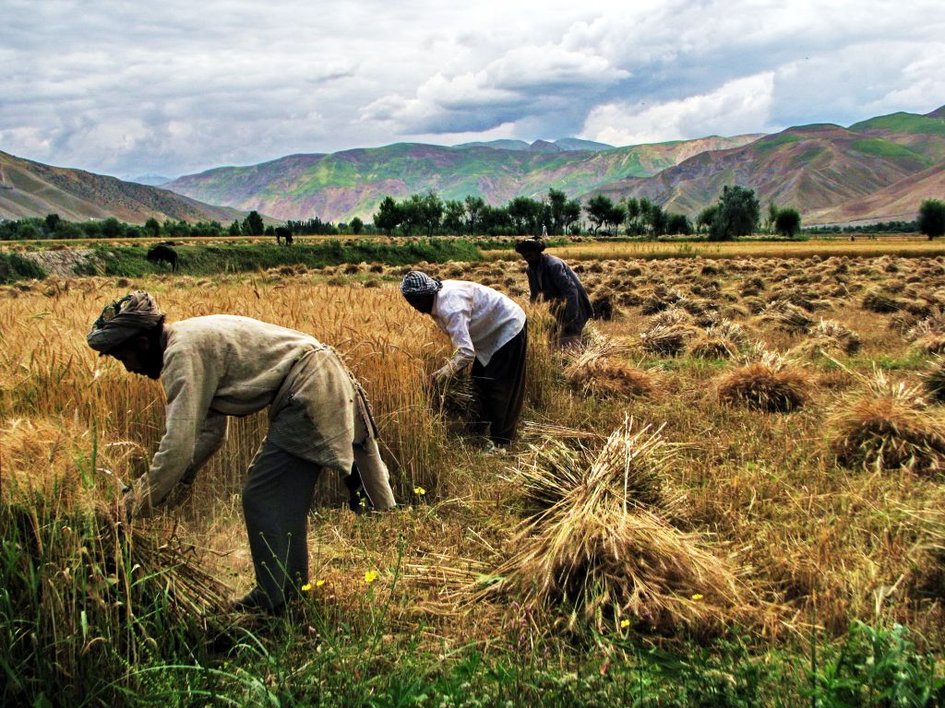
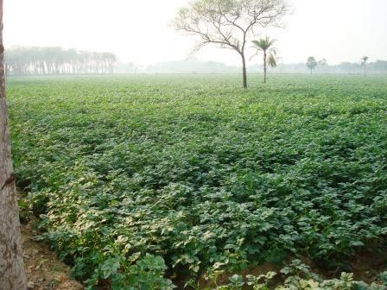
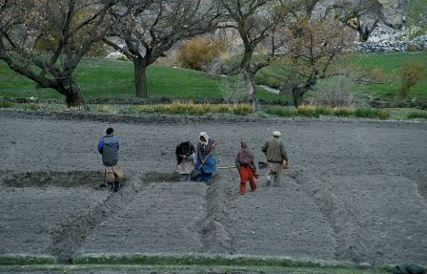
Agriculture & Rural Development
The World Bank Program in South Asia
Simeon Ehui Sector Manager South Asia Agriculture & Rural Development

Slide 2
A Region of Contradictions
Population: 1.6 billion
Rural population: 1.1 billion
Average GDP Growth 2000-2010: 7.1%
Average Agricultural Growth 2000-2010: 3.1%
Largest concentration of poor in the world
Malnutrition higher than Sub-Saharan Africa
Large concentration of conflict and natural disasters

Slide 3
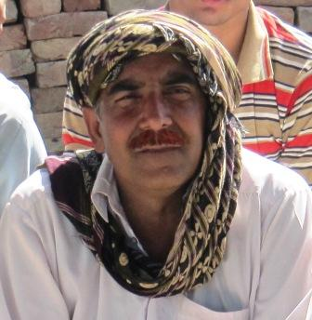
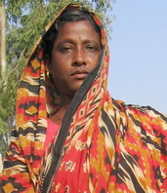
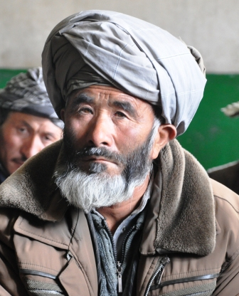
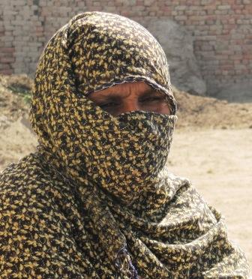
Where do our clients want to be in 2030?
Faster Growth
Higher productivity
Lagging areas
Inclusiveness
Women & res. poor farmers
Economic opportunity
Sustainability
Environmental degradation
Resilience to climate shocks
Food security

Slide 4
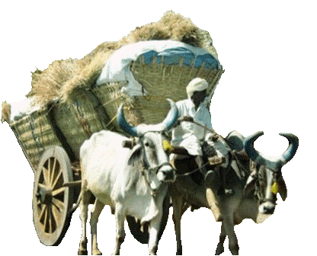
Challenges to Agriculture & Rural
Slowing agricultural productivity growth
Degraded natural resource base (soils, water)
Increasing water scarcity and competition
Declining competitiveness
Demographic pressure, declining & fragmented farms
Neglect of agriculture sector, poor public expenditures
Changes in official development assistance

Slide 5
Constraints and challenges
Climate Change
Adaptation
Price Volatility
Food
Fuel
Conflict
War
Insurgency
Mitigation
Global Crisis
Rule of Law
Disaster
Flood
Drought
Earthquakes

Slide 6
Changing context and opportunities
Better Investment Incentives
New Actors And Business Models
ICT Revolution
Production
Science And Technology
Prices
Taxation
Public-Private-Producers
Financial services
Marketing
Biotechnology
Appropriate technology
Existing technology

Slide 7
How We Work at the World Bank
Country Partnership Strategy
Sector Action Plan
IBRD/IDA Investments
Analytical Work, Studies
Special Programs
Technical Assistance

Slide 8
Our Strategic Objective
To promote inclusive and sustainable rural growth and food security

Slide 9
Operationalizing the action plan
Innovate
Demonstrate
Consolidate and scale-up

Slide 10
Focus areas and building blocks
Empowerment & Poverty Reduction
Natural Resources Management
Productivity
Competitiveness
ITC for financial access, entitlements
Remote Sensing
Water efficient systems
New seeds
New breeds
Spread existing tech
Market information
Quality testing
Technology
Participation laws
Increased awareness of rights
Remote Sensing
Water efficient systems
Incentives for diversification
Price support
Marking laws
Private sector access
Policies & Regulations
Self-help groups
Common interest groups
Watershed groups
Forestry groups
Public sector
Producer groups
Cooperatives
Research & extension
Wholesale markets
Quality regulations & monitoring
Institutions

Slide 11
Differentiated interventions for clients
Landless and subsistence farmers
Smallholders in transition
Commercial smallholders
Safety nets
Crop diversification
Risk Insurance
Market Regulation
Market Efficiency
Value Chains
Rural Non-farm Economy
Skills and Employment
Managing shocks
Value chains
Livelihood Diversification
Knowledge intensive agriculture

Slide 12
Bringing focus to lagging areas: food security and growth
Core sector public investment
Diversification
Natural resource management
Risk Management
Exiting Agriculture
Safety nets, support for alternative livelihoods
Safety nets, management strategies, and innovative financial instruments
Soil nutrient, water efficiency, etc.)
Agricultural research, advisory services, marketing infrastructure
Mobilization and organization
Creating demand for services and organized supply to markets
High-value agriculture, livestock, and value addition

Slide 13
Agriculture & rural comprise 25% of projects and 21% of the Bank’s current commitments in South Asia

Slide 14
Investment on an upward trend

Slide 15
World Bank lending to agriculture is rising . . . dominated by India

Slide 16
Projects and Lending Across the Region (millions)

Slide 17
Significant challenges outside of India
Population | 409 million
Rural Population | 287 million
Average GDP Growth 2000-2010 | 6.9
Ag Contribution to GDP | 20.1
Ag GDP Growth 2000-2010 | 3.1
Coping with ongoing or recently ended conflicts that destroyed infrastructure, livelihoods, and citizen-state relations

Slide 18
Most investment in water and general rural development

Slide 19
Activities and Priorities
Afghanistan
Irrigation restoration
Continued rural rehabilitation
High-value agriculture
Consolidating role of rural institutions (CDCs)
Capacity building of government

Slide 20
Activities and Priorities
Pakistan
Water use efficiency
Emergency response (floods)
Re-invest in R&D and Dissemination
Technology, seeds, breeds, diversification
Market competitiveness
Rural livelihoods for the poor
Rural policies and institutional development

Slide 21
Activities and Priorities
India
Go East Initiative
Water use efficiency - Climate Smart Agriculture
Rainfed agriculture
Technology R&D and Dissemination
Sustainable Land Management
Mixed Crop-Livestock Farm Systems
Farmer Collective Action
Market competitiveness
Rural Connectivity

Slide 22
Activities and Priorities
Nepal
Irrigation rehabilitation
Rural institutions for poverty reduction
Food price crisis response
Improving seed and input systems
Linking producers to markets
Rural Connectivity

Slide 23
Activities and Priorities
Bhutan
Increasing agriculture productivity
Improving farmer livelihoods

Slide 24
Activities and Priorities
Bangladesh
Emergency response (cyclones, flood)
Water management
Rural institutions for poverty reduction
Farmer collective action
Reform of research and extension systems

Slide 25
Activities and Priorities
Sri Lanka
Reconstruction (Northern Province)
Rural infrastructure
Rural institutional development
Irrigation/water management
Market competitiveness

Slide 26
Thank you

